Slide 1
Integrating with APIs
Working with REST and JSON in PHP

Slide 2

Caitlin Bales
Community Engineer @ Microsoft
Working on tooling for APIs
Web enthusiast
Worked on API strategies from creation to consumption

Slide 3
Steps to Integration
Why APIs?
1
Calling APIs in PHP
3
Authenticating your App
4
Debugging Tools
5
RESTful Web Services
2

Slide 4
1 The API Ecosystem

Slide 5
API Industry
Businesses are realizing an API strategy brings them more:
Developer integration
Platform stickiness
Development speed
Some shops are becoming API-first
Reduces friction in cross-collaboration across teams
Increases dogfooding
Avoids technical debt
Great friends with open source development

Slide 6
Why use APIs?
Don’t reinvent the wheel
Spend time building business-differentiated software
Increase your data scope
Faster and cheaper than purchasing off-the-shelf solutions

Slide 7
2 RESTful Web Services

Slide 8
REST
Stands for Representational State Transfer
Message based
A pattern for developing web services
Centered around resources
Provides a common transactional model for data transfer
Lightweight alternative to SOAP and WSDL

Slide 9
JSON Data
Human-readable JavaScript Object Notation
Centers around key-value pairs
Looked to provide more readable format than XML
Most popular formatting for REST call data

Slide 10
Request Recipe
VERB
+
HEADERS
+
URL
+
BODY
GET
POST
PUT PATCH DELETE
…
Accept
Authorization
Content-Length
Content-Type
Host
X-Requested-With
DNT
{
“fname”: “Bob”,
“lname”: “Barker”
}
https://api.site.com/v1/
http://bobsapi.com/users

Slide 11
3 Calling APIs in PHP

Slide 12
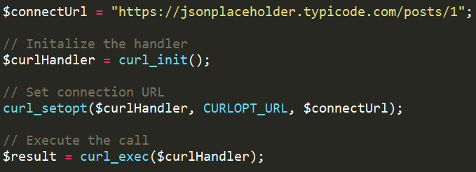
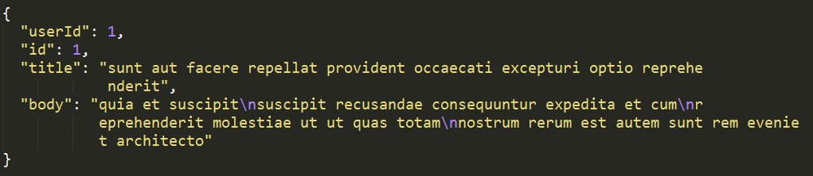
cURL - GET

Slide 13
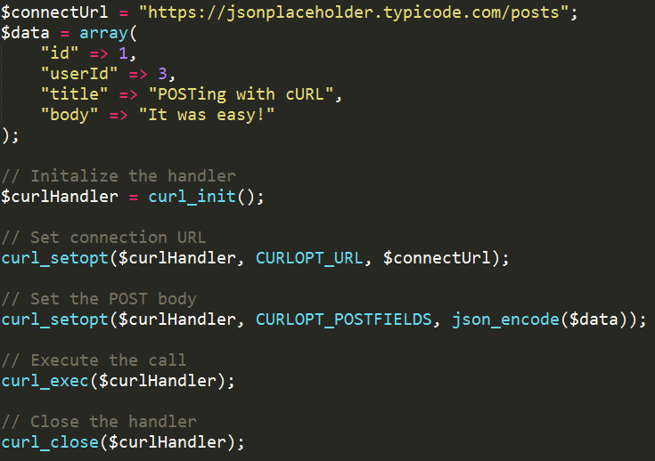
cURL - POST

Slide 14
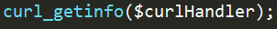
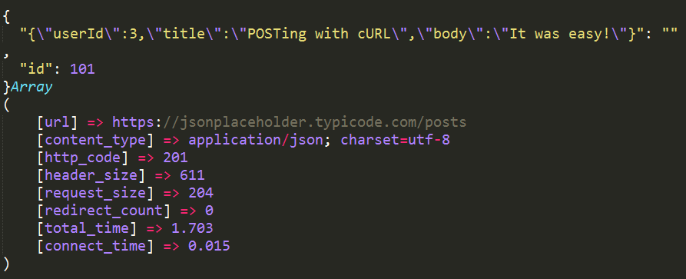
cURL - POST

Slide 15
Guzzle
PHP HTTP client
Handles boilerplate request/response code
Object-oriented
Support for asynchronous calling
Option to use other handlers (i.e. React)
Mock handlers make it easy to test

Slide 16
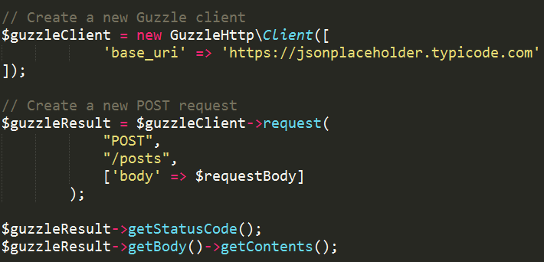
Guzzle

Slide 17
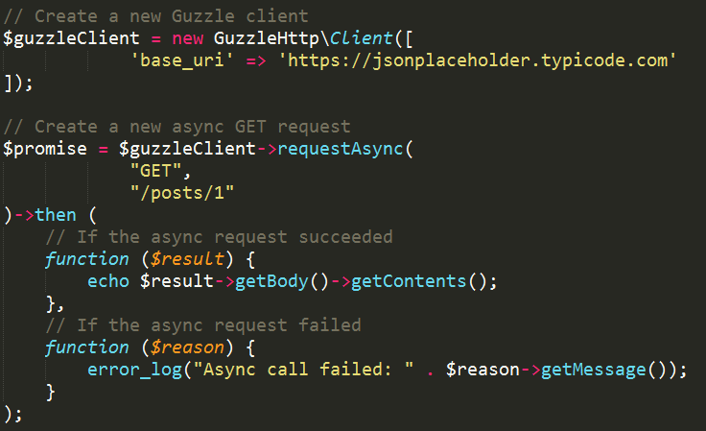
Guzzle - Async

Slide 18
OData
Works with JSON and Atom
Supports querying
$filter, $select
Navigation properties
Deltas
$metadata – XML representation of the objects, navigation paths, and properties available

Slide 19
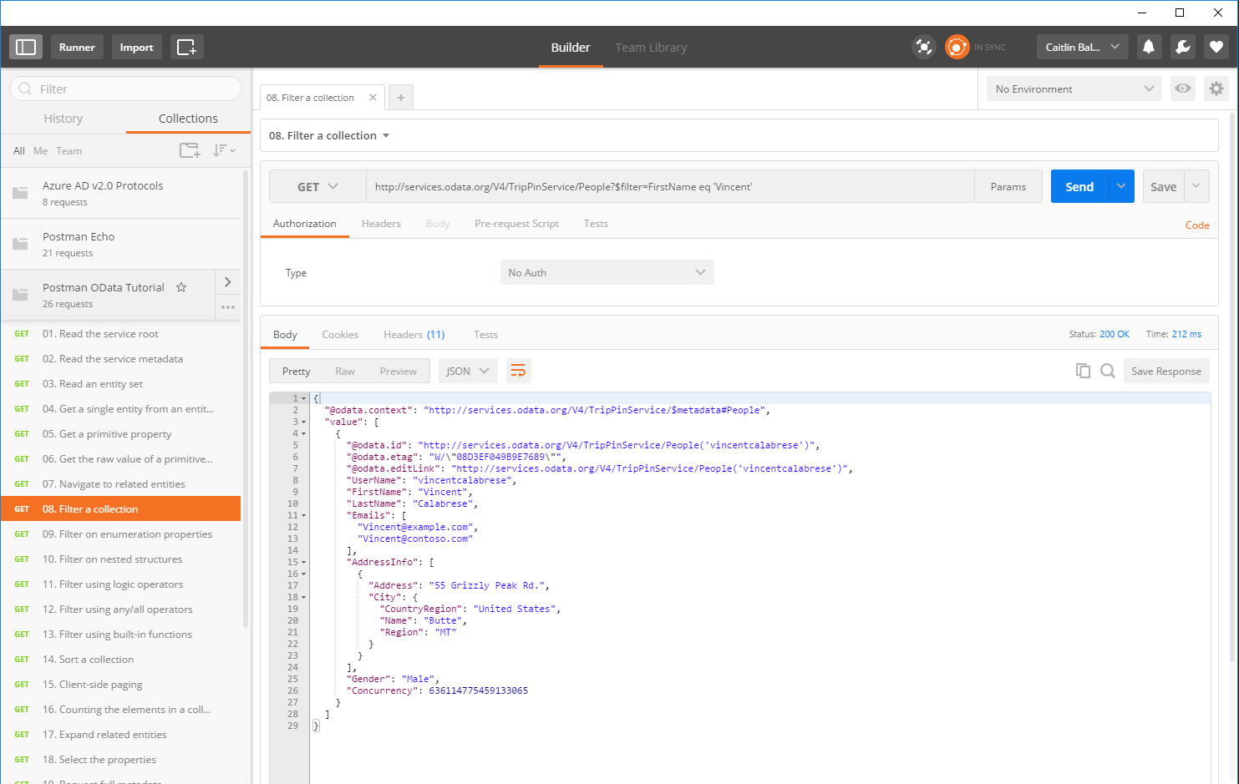

Slide 20
4 Authenticating your App

Slide 21
Authorization & Authentication
Proves to the service that you are allowed to access its resources
Allows you to access public information
Usually involves a public/private key pair
Proves that you are who you say you are
Allows you to access personal information
After authenticating, you receive a token which is then used to authorize you

Slide 22

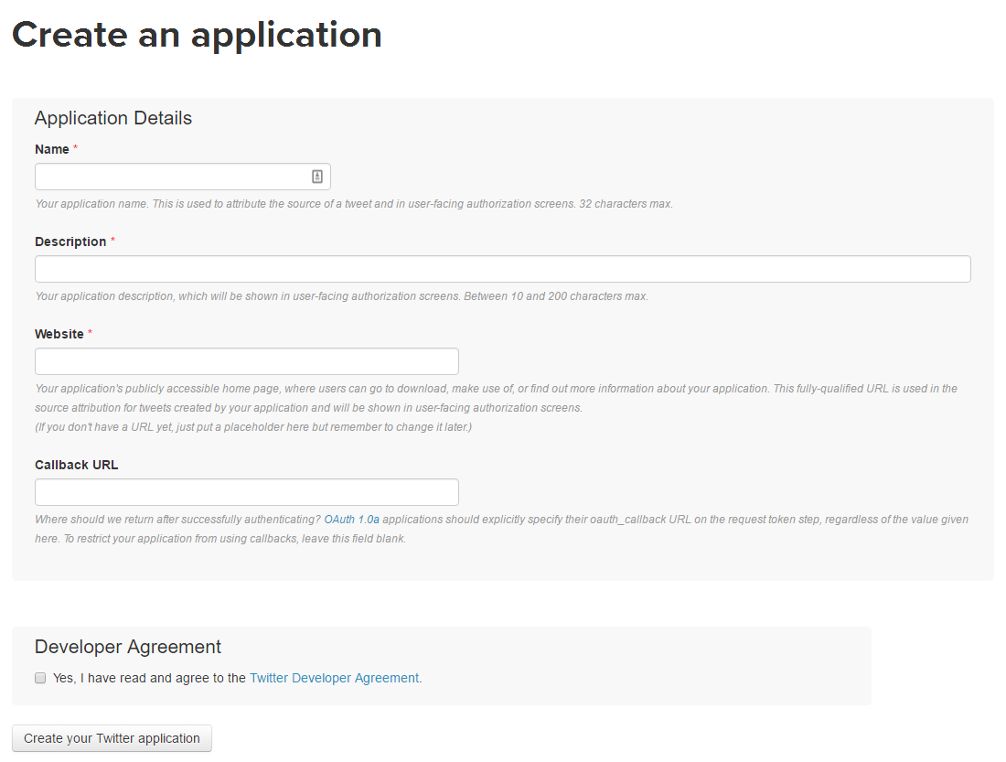
Setting up Authentication with an API
Most companies have you register an application with them on their site
You’ll get a public/private key pair
Callback URL sends you back into your application’s workflow

Slide 23
OAuth2 Flow
The user is prompted to log in to API service and authorize the app to use their data
The server sends back an authorization code to the app
The app uses this code to ask for an access token
The server returns an access token to the client
Subsequent calls to the service use this access tokens
It’s secure because these tokens expire
Using a refresh token, you can get a new valid access token
Notes:
Most services use OAuth or OAuth2 to authorize and authenticate applications

Slide 24
5 Debugging Tools

Slide 25

Postman
Started as a simple Chrome plugin for making HTTP requests
Allows you to test queries quickly without a shell application
Lots of other goodies
Collections
Test cases
Documentation
Sharing

Slide 26
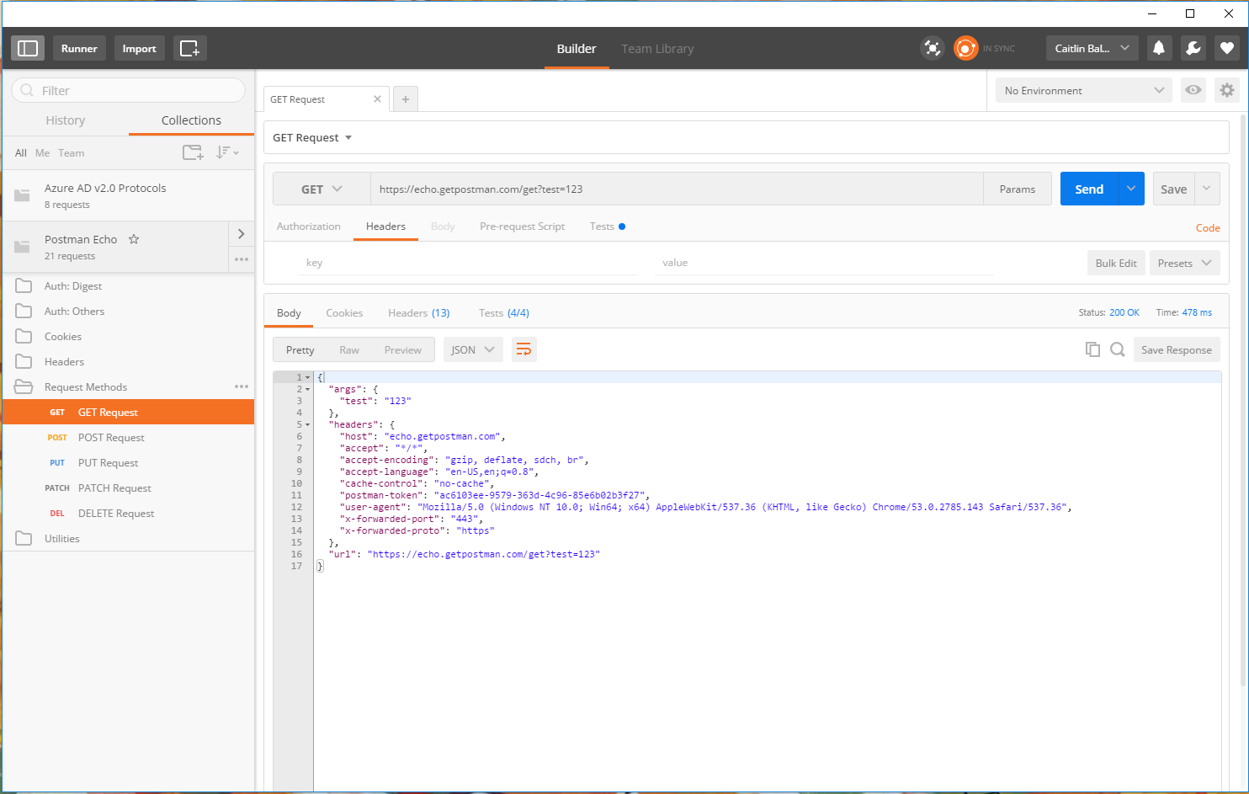

Slide 27

Fiddler
HTTP debugging proxy server
Captures data sent across the wire – Internet, Intranet, and native apps
Allows editing of requests for testing purposes
Intercept requests
Send requests
Mac & Linux builds in Alpha

Slide 28
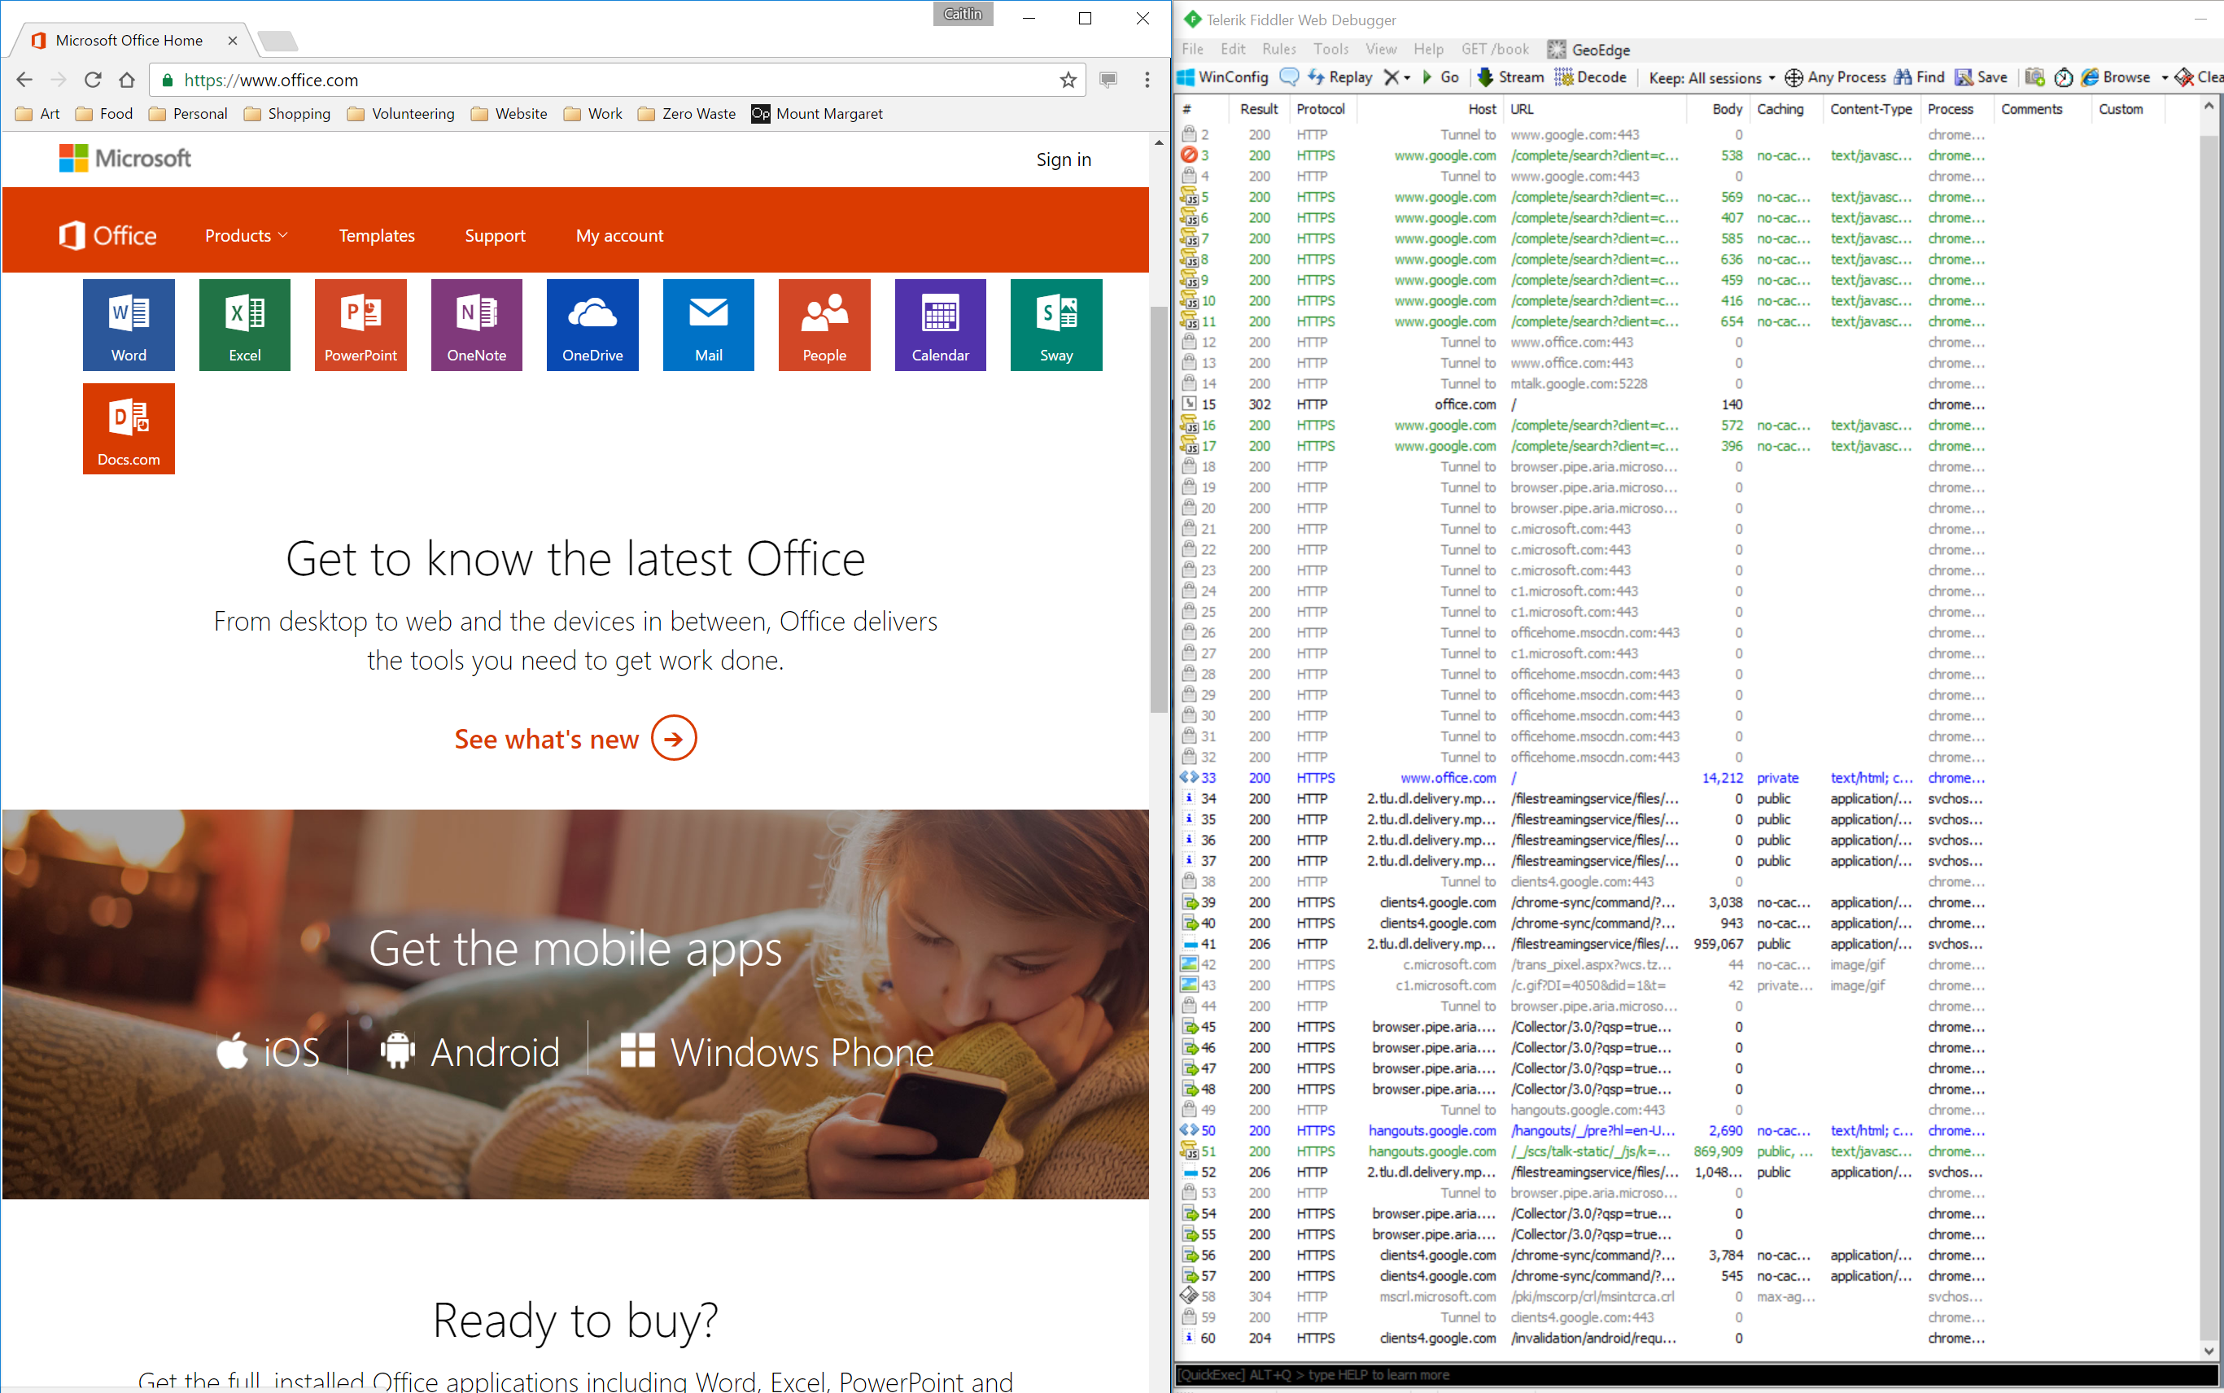

Slide 29
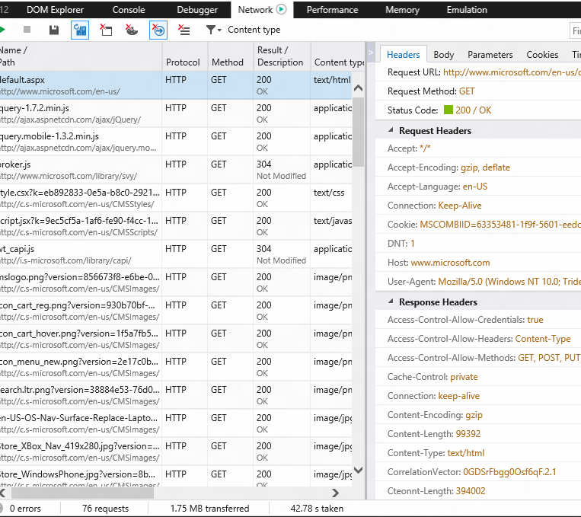
Modern Browser Tools
View requests and responses of web apps
Support remote sessions
Good for sniffing web traffic
There’s even APIs for debugging APIs!

Slide 30
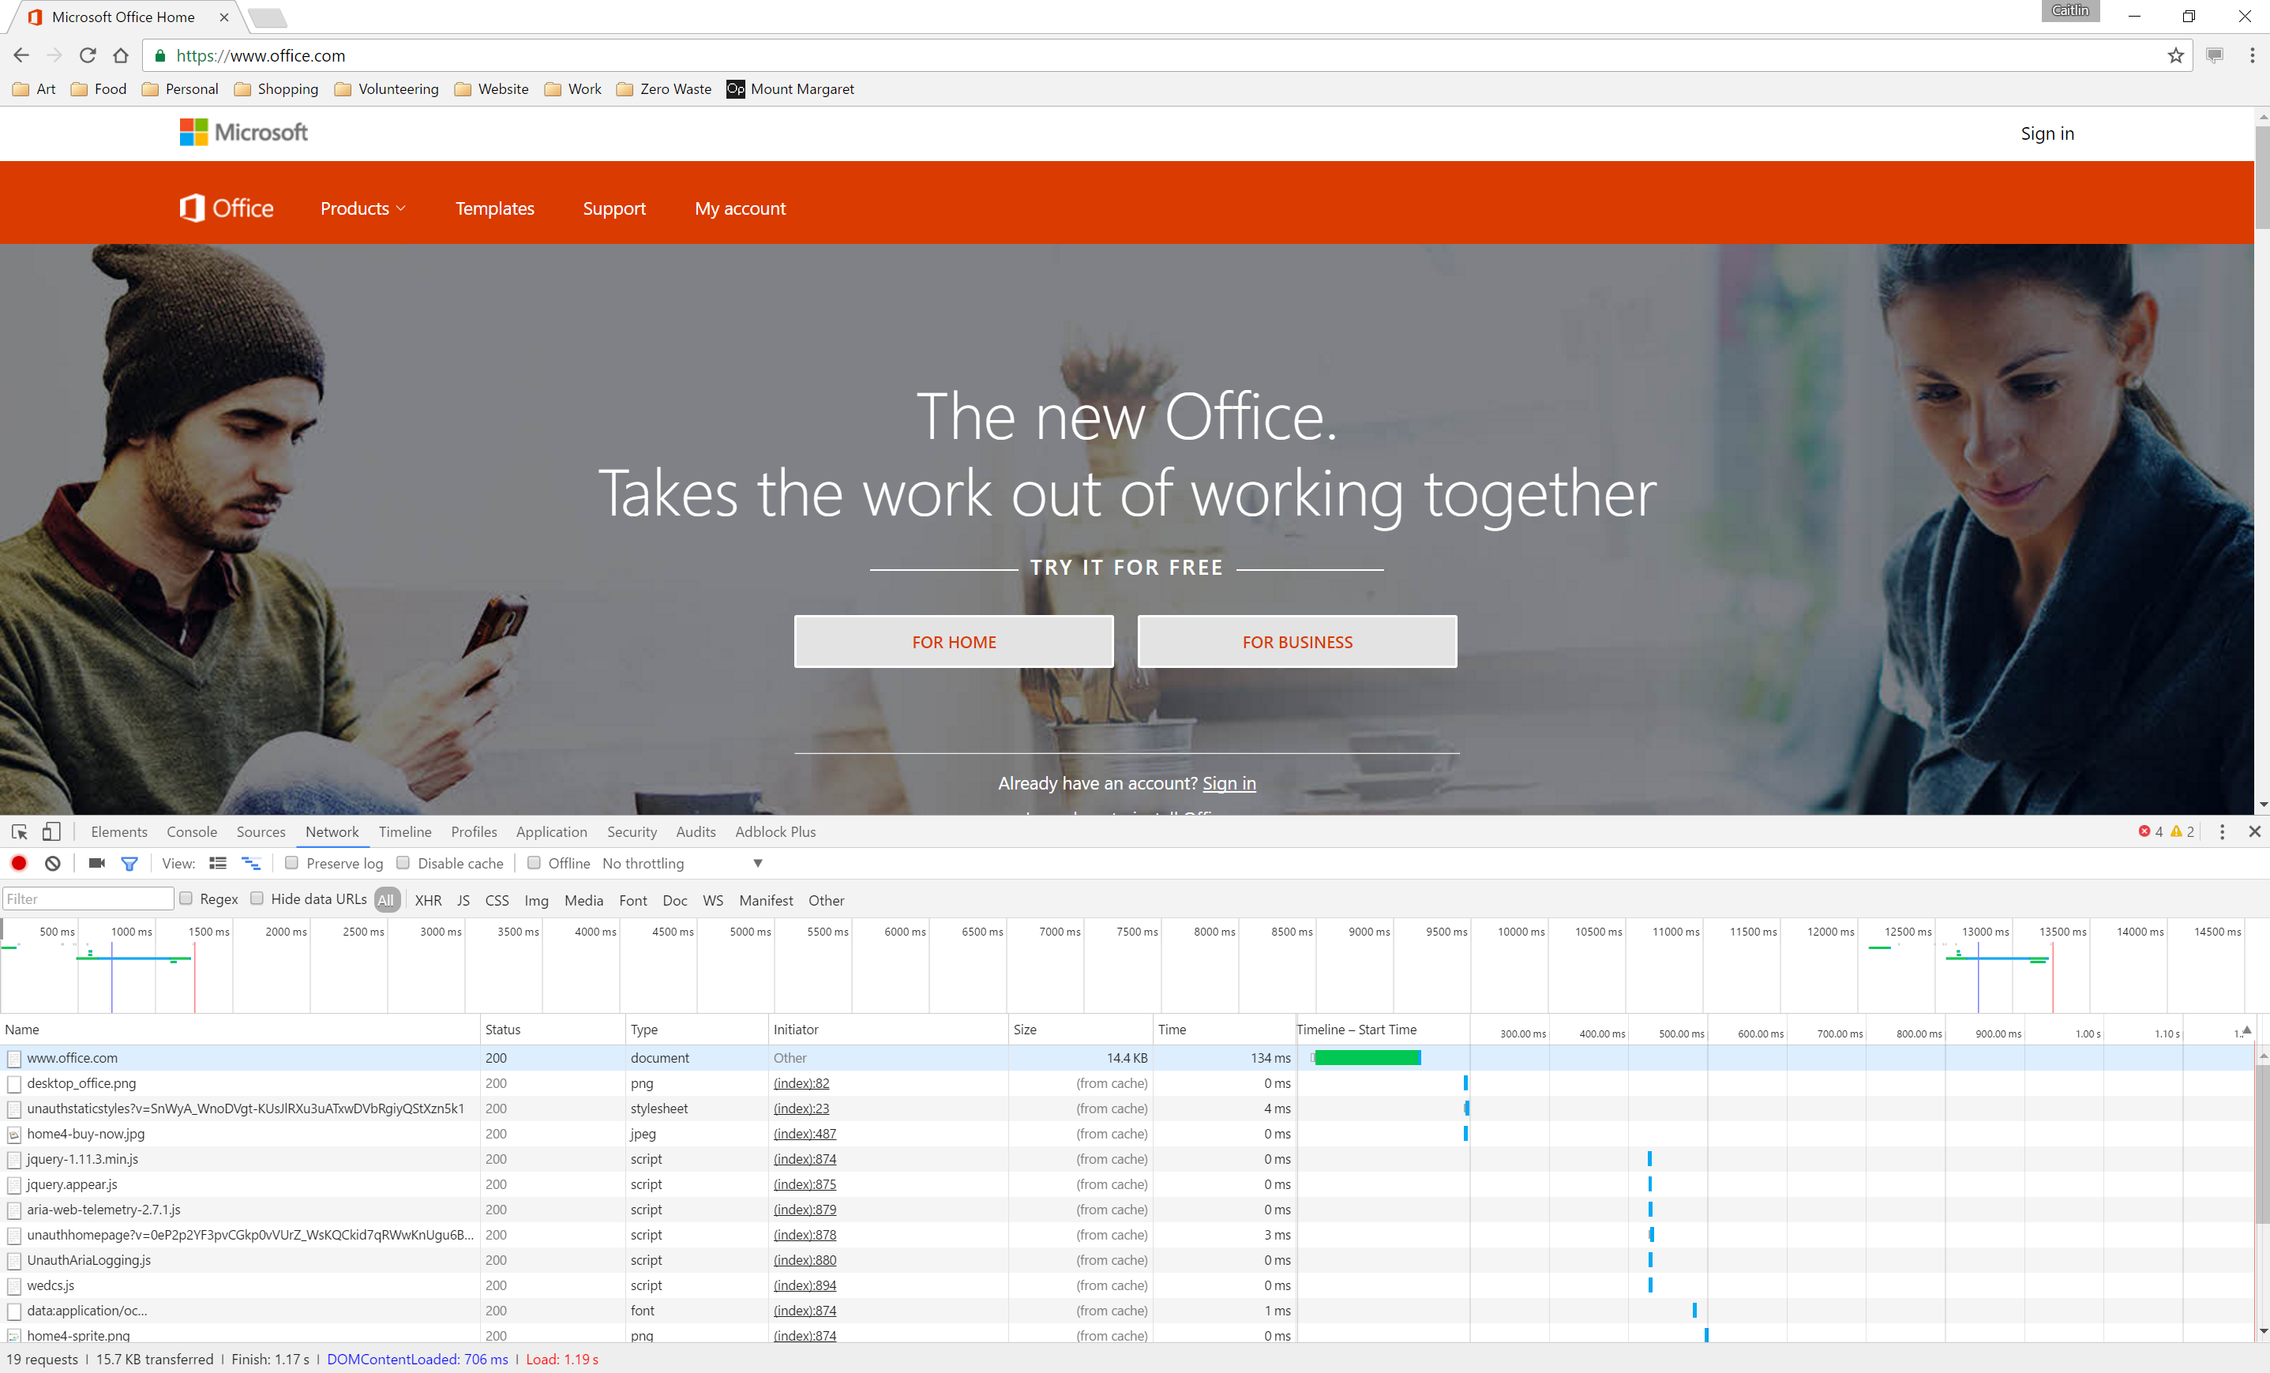

Slide 31
Resources
Slides & sample code – github.com/cbales
Programmable Web
Nordic APIs REST vs SOAP
Build a lightweight API with Slim

